Slide 1
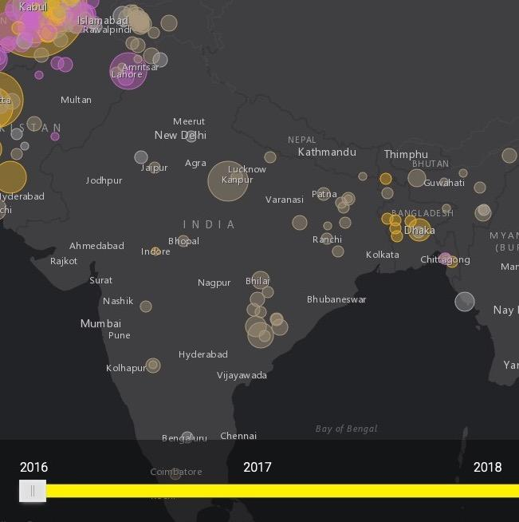
Counter Terrorism using Density Based Clustering and Naive Bayes Classification
Aakash Tanwar (2016215)
Dewangee Agrawal (2016034)
Gagandeep Singh (2016037)
Suraj Prathik Kumar (2016101)

Slide 2
Problem Statement
Terrorism leads to reduced tourism and affects the economy of a country.
Causes fear and anxiety among citizens.
Leads to lots of causality every year.
Terrorist attacks can be combat and controlled unlike other issues like climate change.
Understand the reason behind terrorism and what triggers these groups.
Understand the patterns in frequent attacks - preventive measures can be taken.

Slide 3
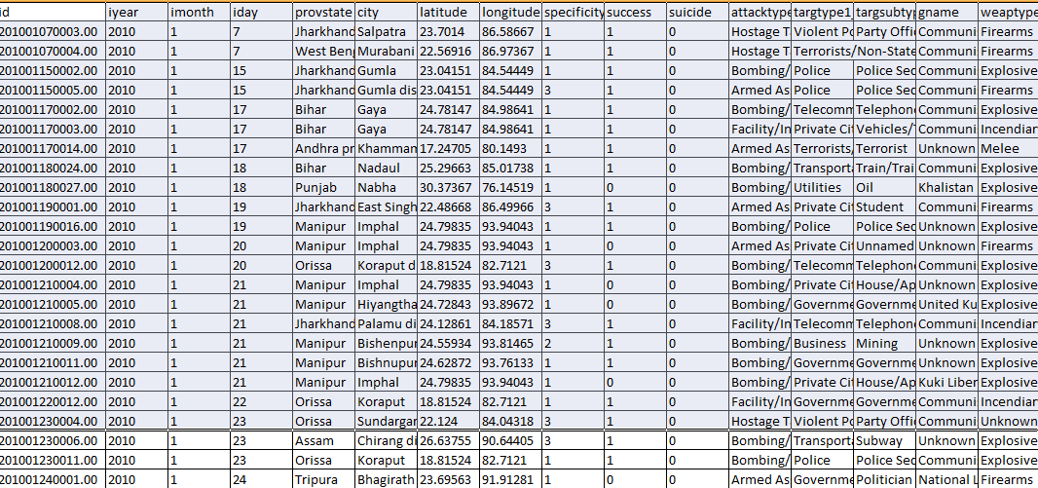
Dataset Used
Kaggle dataset was used. Almost 35 years of data was available.
The dataset was used as the dataset had 135 features ranging from geospatial coordinate to attacks, type of attacks, the type of people attacked etc.
It had specificity feature as well which gave a clear idea as to how correct is the dataset were. With proper analysis suitable inference can be done.
Approach : Data Mining Technique was used as there were 11000 records for India out of 2 lakh records. They were cleaned according to our interest.
Suitable clustering technique used for group analysis.
Using results from our analysis, we tried to predict the attacks occuring in the year 2018 and compared it with the actual occurrences.

Slide 4
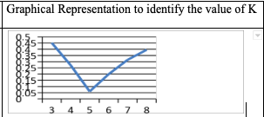
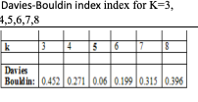
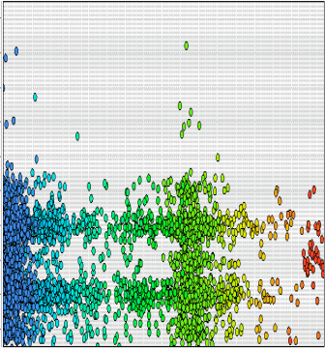
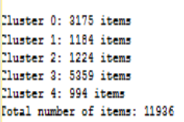
K-Means Clustering
Distance measures (Manhattan, Euclidean) and non-Euclidean distance measures (Jacquard, Cosine) used to find the distance between points.
Cluster Distance Performance operator of RapidMiner used to find out Davies-Bouldin index for value of K.
Inference - 5 Spherical clusters obtained.
Disadvantages
The outliers were also stored within the clusters.
Spherical clusters were too huge and not accurate.
Difficult for analysis.

Slide 5
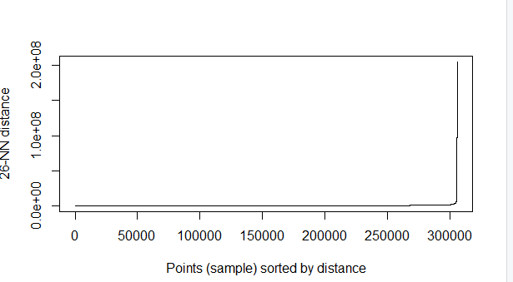
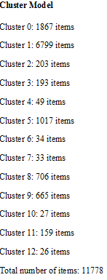
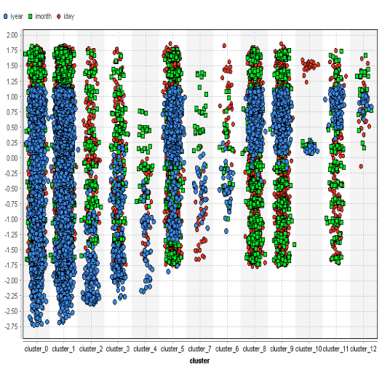
Density Based Clustering Analysis (DBSCAN)
Density is the number of points within a specified radius Eps and Minimum number of points within the specified distance.
We fixed the value of minimum points and calculated the value of Eps by forming the kk-distance graph using R.
The minimum points was fixed to 25 and the epsilon value obtained was 1.
Advantages
No need to specify the number of clusters compared to K-Means where the value of K has to be determined before the start of the algorithm.
Forms of arbitrary-shaped clusters.
It deals with different attribute types and data of high dimensionality.
Insensitive to noise and outliers.
The result obtained is interpretable and usable.

Slide 6
Naive Bayes Classification
Uses Bayes’ Theorem to predict class probabilities
Features are considered independent of each other
Advantages
Categorical and continuous values are supported.
Only the variance of the variables for each label to be determined due to independent features.
Intensity of computational memory and processing is low.
The training time is also less compared to other methods.
Outcome - Attack on Feb 10,2018 in Sunjuwan, away from Sopore.
Prediction - Attack on Feb 19, 2018 in Sopore, Jammu.
Outcome - Attack on May 4, 2018 in Tinsukia, Assam.
Prediction - Attack in Ramnagar, 600 km away from Tinsukia.
Outcome - Attack on Oct 20, 2018 in Imphal, Manipur.
Prediction - Attack in Wangoi, 17.2 km from Imphal.

Slide 7
Result and Observation
It has been observed from the clusters that the frequently targeted months are budget session months of the Parliament.
Constitution Day (Samvidhan Divas) on 26 November is celebrated to commemorate the adoption of Constitution of India. Many clusters showed that there are frequent attacks on date 26 of months or around 27 ,28 of different months.
There were several attacks in 2003 after Nov 23 when India accepted Pakistan’s offer of a ceasefire in Kashmir.
The targets were mostly defense or police personnel.
The attacks were repeated on specific dates like 11/23 and 11/25. The eastern region of Kashmir like the town of Sopore is affected several times because of the Pakistan border, as it is easy for the terrorists to enter.
A pattern has also been recognized that the Eastern coast of India is attacked with terrorists finding their way to enter through Arabian Sea.

Slide 8
Inference and Conclusion
Muslim and Sikh extremists played an important role in the attack (1983-2004).
Amritsar District, Doda District, Firozpur district Gurdaspur District, Jalandhar district (1984-2008).
The reason for the attacks could be the May 21, 1991 assassination of Mr Rajiv Gandhi by LTTE. (1991).
Number of Arms and Ammunitions Ammunitions Recovered from Smugglers in India that were Smuggled from Bangladesh and brought to West Bengal (2010-2012).
Military Personnel, Police Patrol are mostly targeted.
The dates 9,23,26 are widely used for attacks and in November dates 23,24,25,26,27,30 were repeatedly used for attacks.
In some cases Business/Private Citizens Property repeatedly targeted in Gujrat.
In Srinagar most of the target dates were 27th from 2011 to 2018

Slide 9
Thank You

